Slide 1
Cloud Solution Architect
Module 3
Lecture 9
Cloud Computing Infrastructure, AWS, GCP, Azure interface overview

Slide 2
Recap
Module 2 - Lecture 8
  SSH server
  Firewall
  Iptables
  web server

Slide 3
Learning Objectives
Module 3 - Lecture 9
  Cloud Infrastructure
  AWS Interface
  GCP Interface
  Azure Interface

Slide 4
Cloud Infrastructure
  Hardware and Software components
    servers
    storage
    networking
    virtualization
    services
    management tools

Slide 5
Hardware
  Hardware components
    servers
    Firewalls
    Switches
    Routers

Slide 6
Storage
  Block Storage
    Block-level storage is a concept in cloud-hosted data persistence where cloud services emulate the behavior of a traditional block device, such as a physical hard drive. It is a form of network-attached storage. Storage in such services is organized as blocks
  File Storage
    data is saved in files and folders, and presented to both the system storing it and the system retrieving it in the same format.
  Object Storage
    Object storage is a computer data storage architecture that manages data as objects

Slide 7
Networking
  LAN
    a computer network that interconnects computers within a limited area such as a residence, school, laboratory, university campus or office building
  WAN
    A wide area network is a telecommunications network that extends over a large geographic area
  MAN
    A metropolitan area network is a computer network that interconnects users with computer resources in a geographic region of the size of a metropolitan area

Slide 8
Virtualization
  Paravirtualization
    a virtualization technique that presents a software interface to the virtual machines which is similar, yet not identical, to the underlying hardware-software interface
  Full Virtualization
    a virtualization technique used to provide a VME that completely simulates the underlying hardware
  Server Virtualization
    the process of creating multiple server instances from one physical server

Slide 9
Services
  IaaS
  PaaS
  SaaS

Slide 10
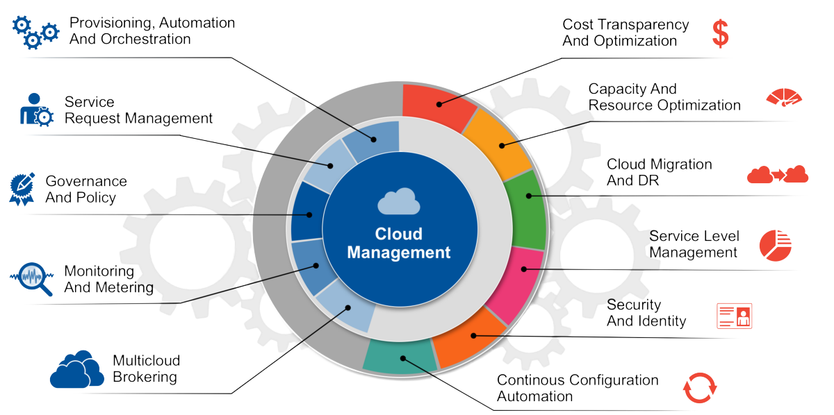
Management Tools

Slide 11

AWS - Interface
  Amazon Web Services
  A subsidiary of Amazon that provides on-demand cloud computing platforms
https://aws.amazon.com/

Slide 12
AWS Services
  EC2
  S3
  RDS
  EBS
  EFS
  VPC

Slide 13
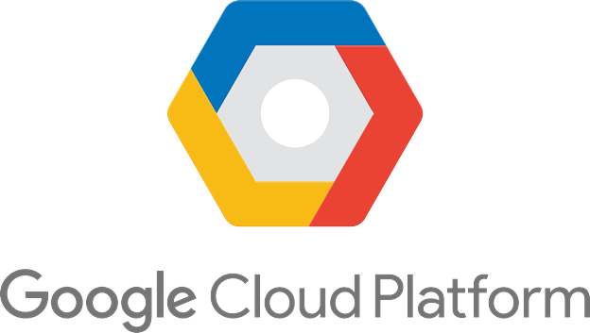
GCP Interface
  Offered by Google
  A suite of cloud computing services
  Runs on the same infrastructure that Google uses internally for its end-user products like google drive, gmail etc
https://cloud.google.com/

Slide 14
GCP Services
  Google Compute Engine
  Google Storage
  Cloud SQL
  GCP Cloud Storage Nearline
  VPC

Slide 15

Azure Interface
  Offered by Microsoft
  a cloud computing service operated by Microsoft for application management via Microsoft-managed data centers
https://azure.microsoft.com/

Slide 16
Azure Services
  VM
  Blob
  SQL Database
  Glacier
  File Storage
  VPC

Slide 17
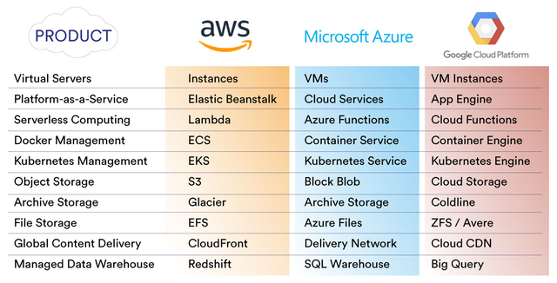
Cloud Services Comparison

Slide 18
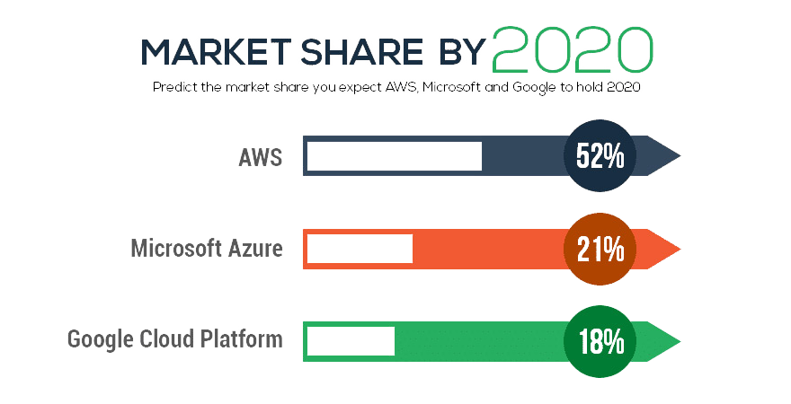
Market Share

Slide 19

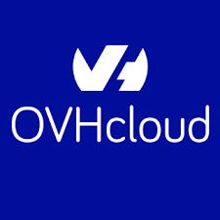
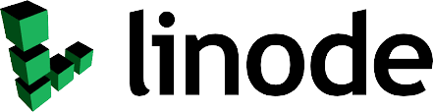
Other Cloud Platforms

Slide 20
Learning Objectives
Module 3 - Lecture 9
  Cloud Infrastructure
  AWS Interface
  GCP Interface
  Azure Interface

Slide 21
Next Lecture
Module 3 - Lecture 10
  AWS
  Identity and Access Management
  IAM Roles
  Creating basic VMs (EC2)

Slide 22

Ask Questions!!

